Slide 1
K8⁺ Merkel cells are progressively lost during active hair growth
Telogen
Anagen
Catagen
Merkel cells (K8)
Afferents (NFH)
Myelin sheaths (MPB)
___
Median
n=3–4 mice &
17–31 touch domes
per group
Day:
Notes:
Data are published in Marshall, Clary et al. (2016) PMCID: PMC5142614
• Use legible, san sarif fonts
• Rigor: report sample sizes, statistical tests & include P values, when applicable
• Rigor: Show raw data when sample sizes are amenable, otherwise note whether means and medians are shown. Define error bars (e.g., SEM, SD).
• Define colors, scales & axes.
• Simplify graphics & use schematics to summarize experimental design details. Use popups strategically to focus your viewers’ attention.

Slide 2
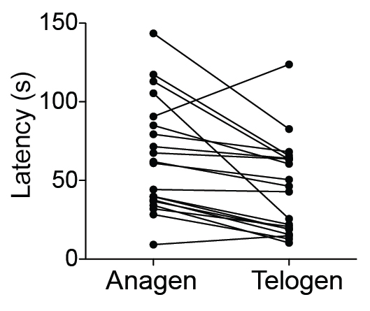
What are the functional consequences of neuronal plasticity?
*P=0.0014, Wilcoxon
matched sign-rank test; n=20 mice

