Slide 1
The Role of Animals in Basic,
Medical, and Veterinary Health Research
Revised: 2024

Slide 2
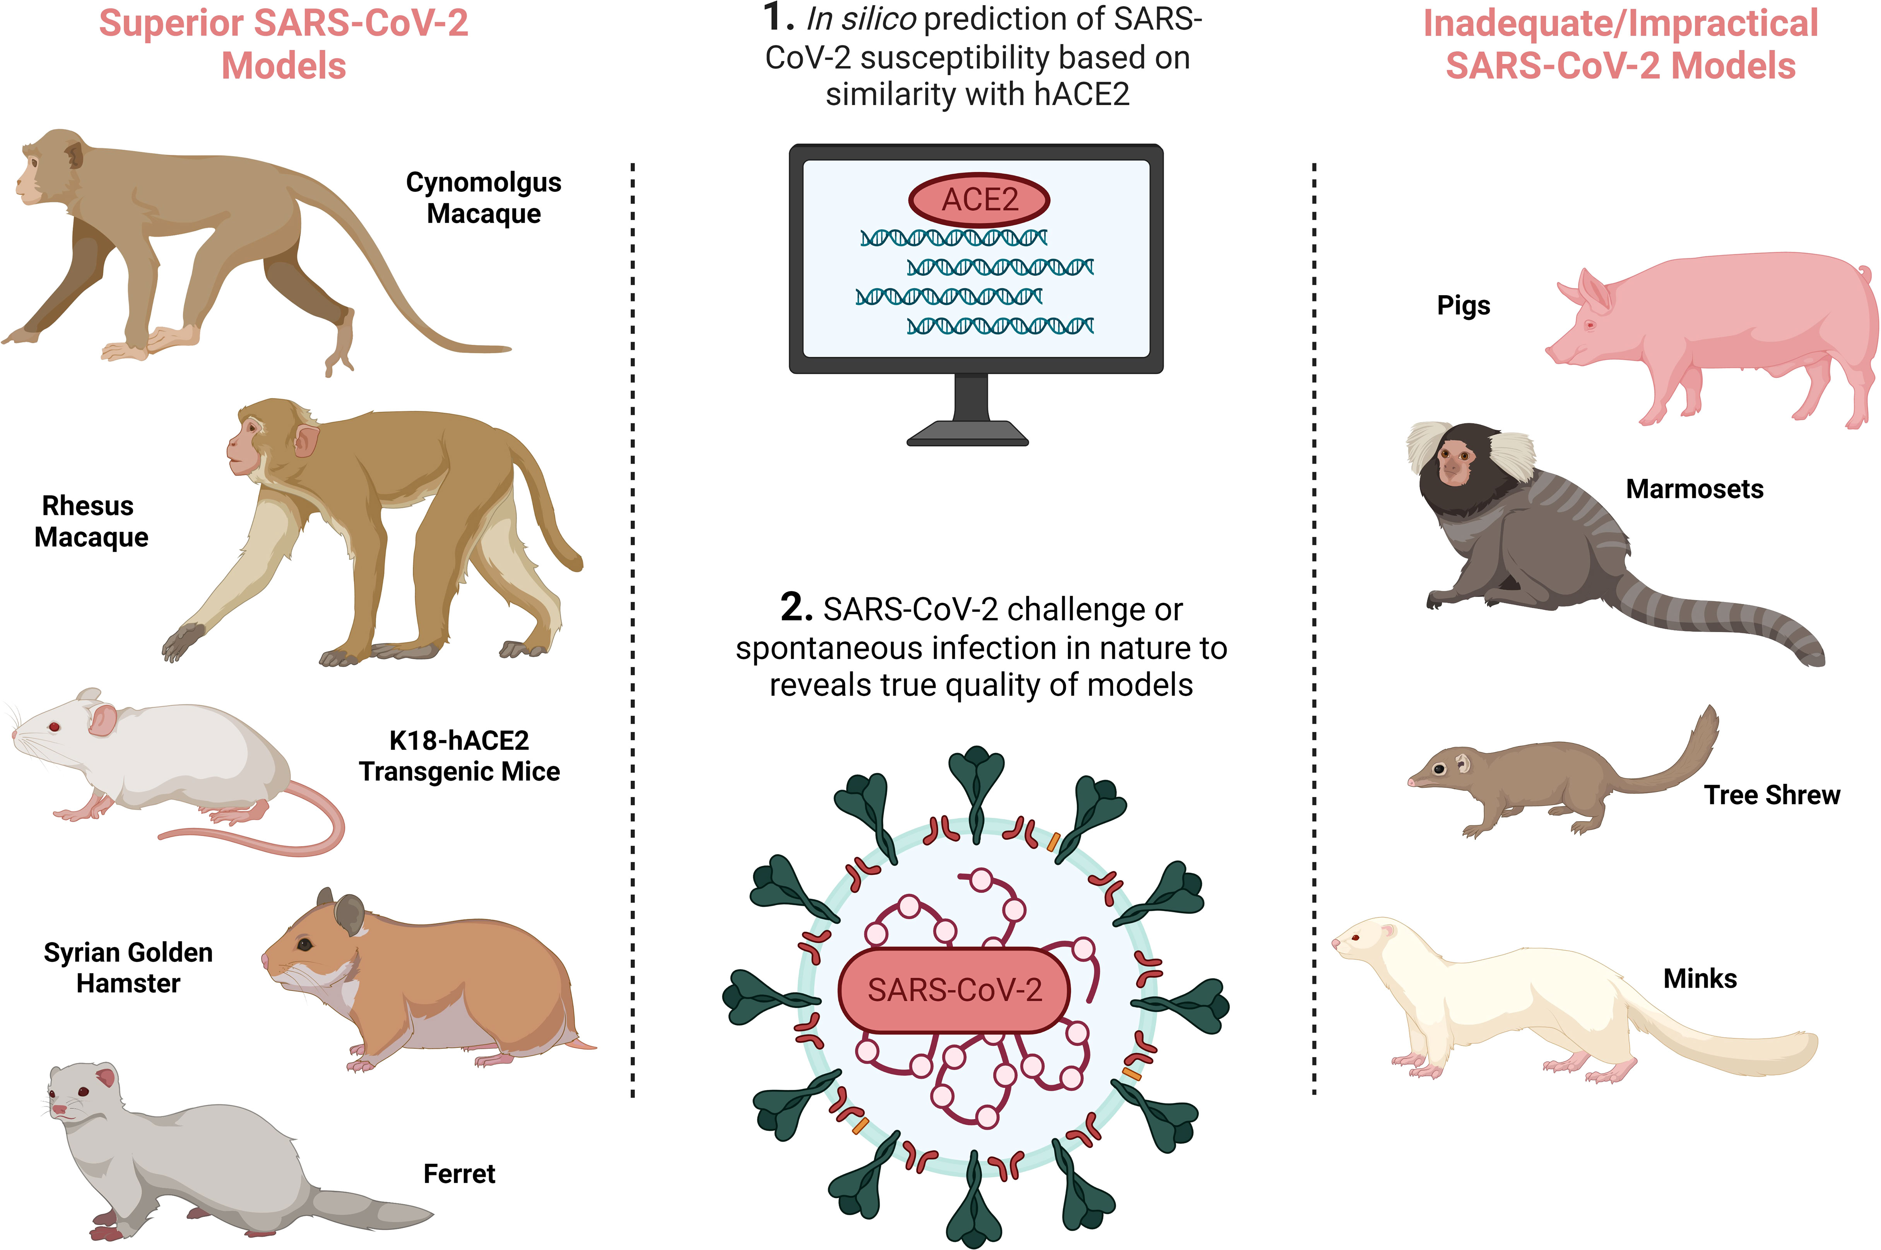
Why Researchers Select A Specific Animal Model
Biological similarity between animal model and human
Genetic traceability
Behavioral similarity
For example, animals models used to study COVID-19
Source:Brady C, Tipton T, Longet S and Carroll MW (2023) Pre-clinical models to define correlates of protection for SARS-CoV-2. Front. Immunol. 14:1166664. doi: 10.3389/fimmu.2023.1166664

Slide 3
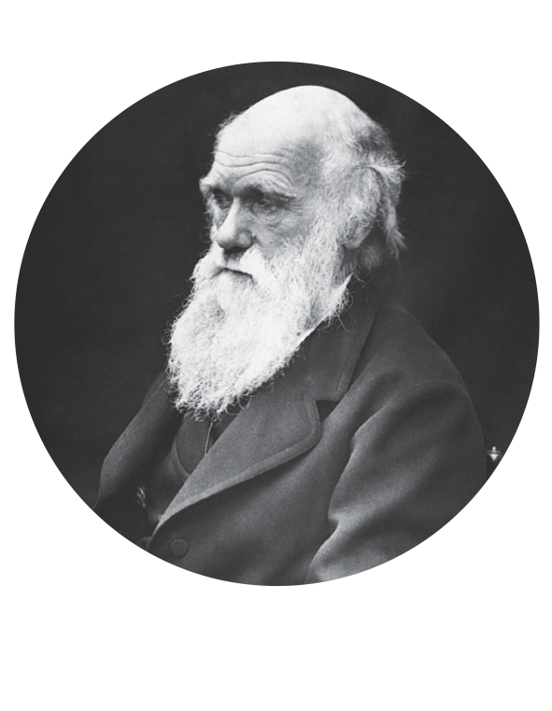

Animal research contributed to
70% of Nobel prizes in physiology or medicine
"I know that physiology cannot possibly progress except by means of experimenting on live animals, and I feel the deepest conviction that he who retards the progress of physiology commits a crime against mankind.”
Charles Darwin
The London Times, 1881
Notes:
Introduce importance of animal research for medical progress
Nobel prize percentage source: https://speakingofresearch.files.wordpress.com/2008/03/medical-advances-and-animal-research1.pdf
Quote source: Darwin CR. Mr. Darwin on vivisection. The Times of London 1881;10. as quoted in: Ringach DL. The use of nonhuman animals in biomedical research. Am J Med Sci. 2011 Oct;342(4):305-13. doi: 10.1097/MAJ.0b013e31822a6c35. PubMed PMID: 21817874.
For example, utilizing genetic likeness of animals for scientific progress.
Transgenic animals are useful models to:
Study disease development
Evaluate medicines and gene therapies
Produce and test the purity of human therapeutic proteins

Slide 4
The Beneficiaries of Animal Research
Our Communities
Our Environment
Our Pets
(Image: SVPAZ)
Our families, friends and peers all benefit from the lifesaving advances made possible with the use of animals in biomedical research
Pets suffer from many of the same diseases as humans and thus benefit from some of those same treatments developed from animal models
Animal research provides an understanding of the environment and the interconnected/biodiversity of life
Notes:
Without animal research, who would lose? Introduce listed beneficiaries: medical advances through animal research help humans, the health of our pets, and provide an understanding of our environment and the interconnectedness / biodiversity of life
Pets suffer from many of the same diseases as humans and, thus, benefit from many of the same treatments developed via animal research (e.g., similarities between feline immunodeficiency virus and HIV). Pets’ food, medicines, and vaccinations were developed using animal research. For example, many puppies died within months of contracting canine parvovirus until the vaccine was developed via animal research in the early 1980s.

Slide 5
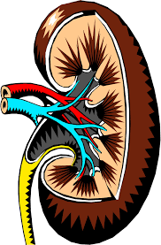
Human Health Advances
Examples of medical advances based on animal research:
deep brain stimulation (Parkinson’s disease and mood)
kidney transplants
insulin injections
Kidney transplants
dogs and pigs
MMR vaccine
nonhuman primates
Insulin
dogs, rabbits, and mice
Polio
mice and nonhuman primates
Blood transfusions
dogs, guinea pigs, and rabbits
DEEP BRAIN STIMULATION
nonhuman primates
Gene therapy retinitis pigmentosa
dogs
Penicillin and Streptomycin
mice and guinea pigs
COVID-19 VACCINE
mice and nonhuman primates
HIV TREATMENT
mice, felines, nonhuman primates
“There could have been no oral polio vaccine without the use of innumerable animals.”
Albert Sabin, Polio researcher
Notes:
Virtually all medical advances utilized animal research models at some point in the R & D process
Model system used for discovery is listed alongside medical advance
Source: https://speakingofresearch.files.wordpress.com/2008/03/medical-advances-and-animal-research1.pdf
https://speakingofresearch.com/facts/medical-benefits/

Slide 6
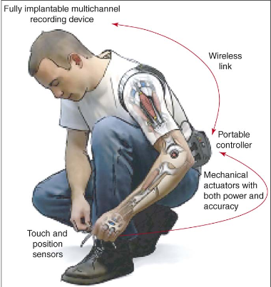
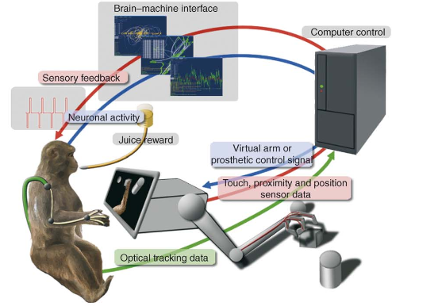
Limb Function Through Advances in
Brain Machine Interfaces (BMI)
BMI technology informed by nonhuman
primate neuronal recordings
BMI’s potential to restore
limb mobility
Source: Lebedev & Nicolelis. Trends in Neuroscience. July 2006.
Notes:
BMI involves a direct connection between the brain areas associated with movement and a wired device like a prosthetic. Neuronal activity is recorded and processed through a computer to power the robotic arm. Feedback from sensors on the arm is converted to micro stimulation of sensory brain areas. BMI aims to generate a prosthetic that feels and acts like a human limb. BMIs may be used as therapy for restoring motor control in disabled individuals. More information can be found at http://www.brainfacts.org/in-the-lab/animals-in-research/2016/animal-research-success-stories-brain-machine-interface-090616
Images from: http://www.afanporsaber.es/files/homepage/group/loveLAB/love/classes/design/readings/bmi2.pdf

Slide 7
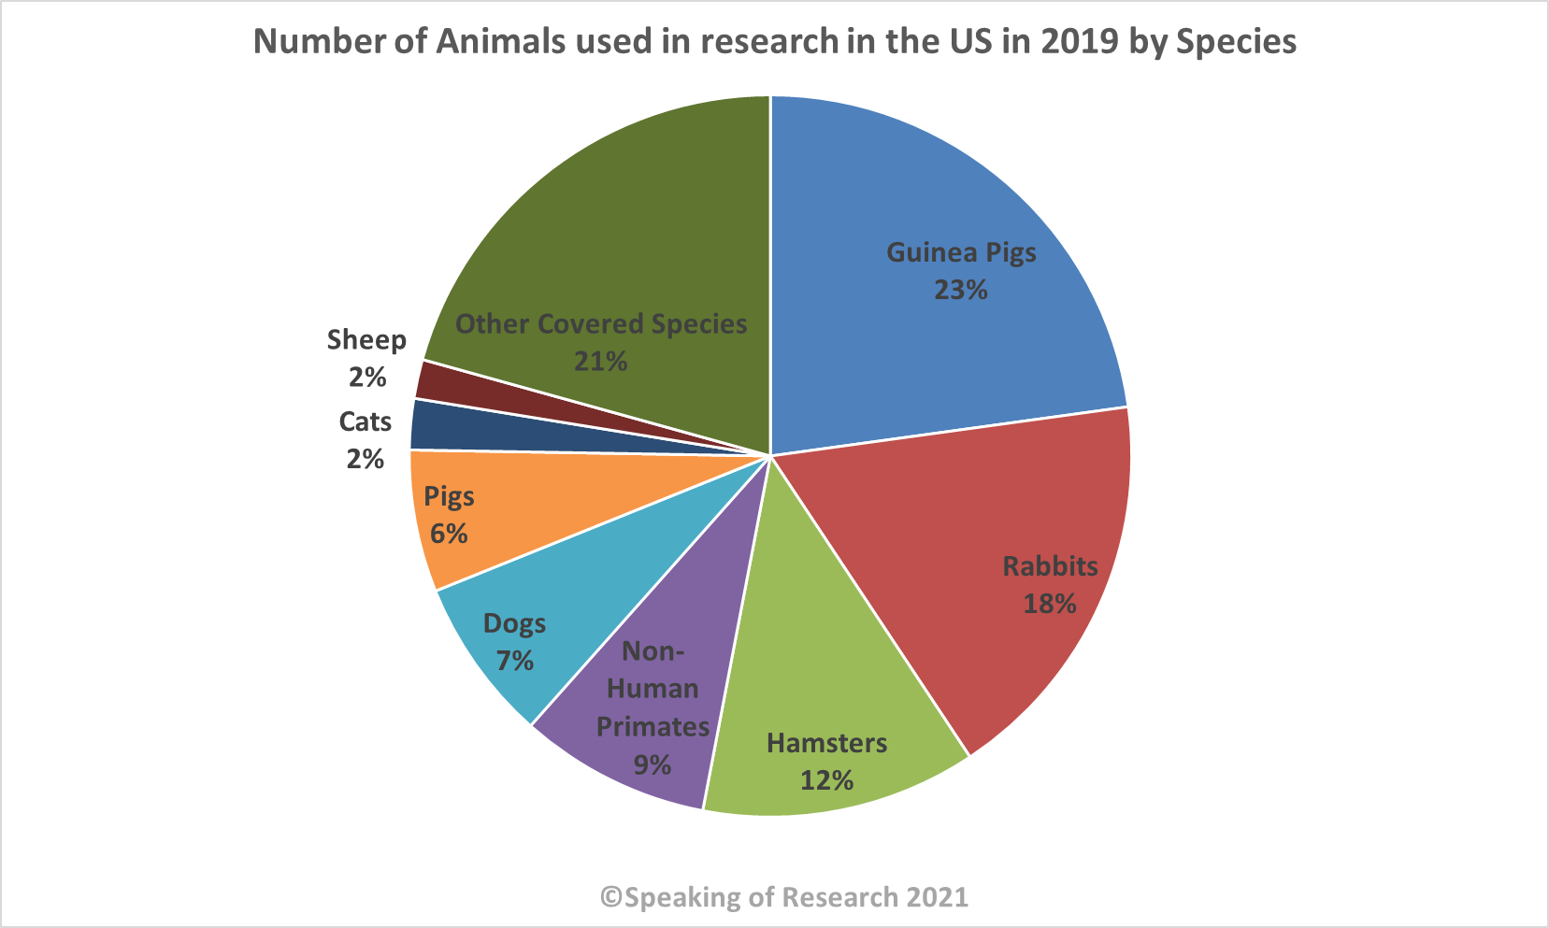
Laboratory Animals: ‘Partners’ in biomedical innovation
Laboratory Animals in U.S.
Source: Speaking of Research. 2021.
Notes:
The majority of animals in biomedical research are rodents with a small percentage of researchers working with cats, dogs, and NHPs.
Source: Love Animals? Support Animals in Research. Foundation for Biomedical Research. September 2017.

Slide 8
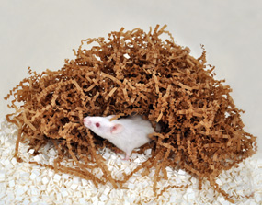
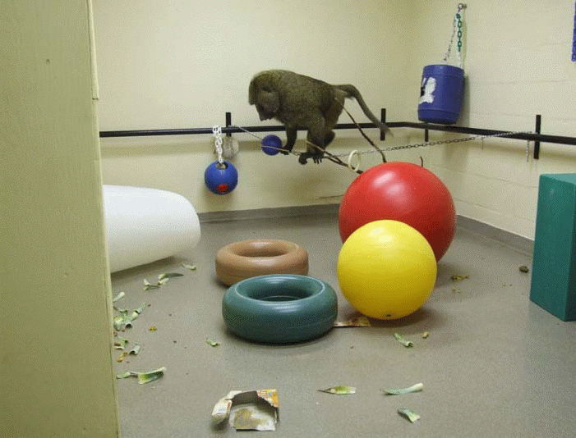
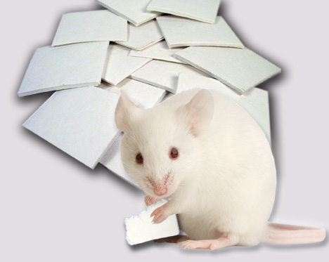
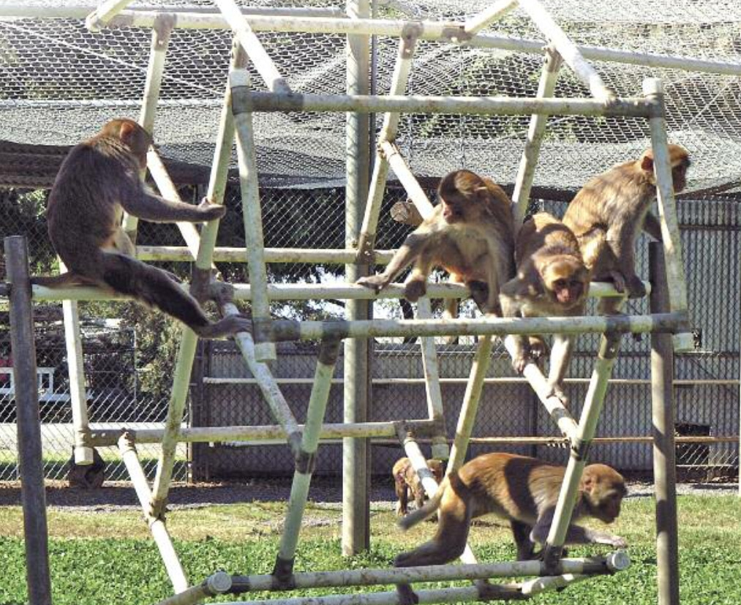
The Health and Wellbeing of Animals is Critical for Rigorous Science
Health Care
cared for daily by animal welfare
staff and regularly monitored by veterinarians
Nutrition
veterinarian approved diet
Environment
clean with minimal stressors
Psychological
species specific enrichment
Notes:
Laboratory animals are kept in clean, enriched environments with oversight from veterinarians and behavioral experts.
Photo source: https://nprcresearch.org/primate/NHP-White-Paper-Print-08-22-16.pdf

Slide 9
Scientific Progress and Ethical Progress
Scientific Progress and Ethical Progress should go hand-in-hand
Scientists take what they learn via the scientific process and turn that into ethical advancements
Examples:
      Scientists learned that nursery rearing of monkey's results in abnormal behavior, so many scientists are turning to other methods such as developmental studies in naturalistic contexts
      Scientists now understand that how samples are collected (sedated vs “forced” vs “PRT”) has influences on many biological factors
      Scientists now know that the animal’s environment can impact immune function which has consequences for disease progression and treatments
Notes:
Laboratory animals are kept in clean, enriched environments with oversight from veterinarians and behavioral experts.
https://www.science.org/stoken/author-tokens/ST-1503/full
https://scholar.google.com/scholar?hl=en&as_sdt=0,5&cluster=369453231432854284
Photo source: https://nprcresearch.org/primate/NHP-White-Paper-Print-08-22-16.pdf

Slide 10
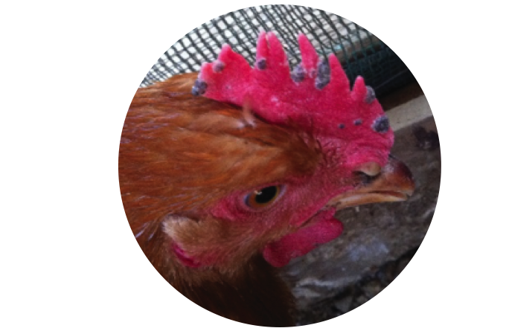
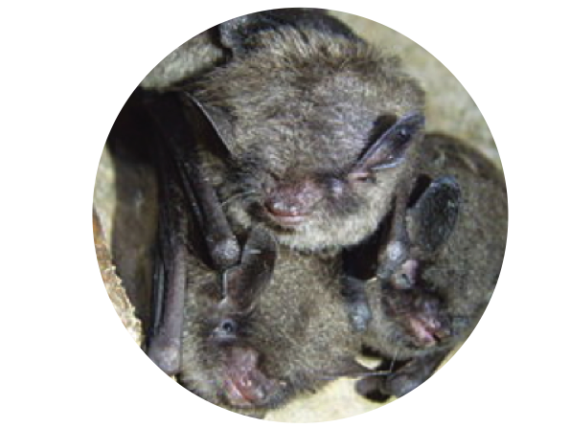
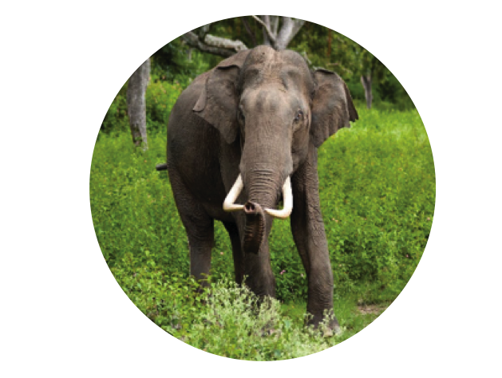
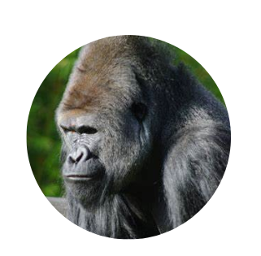
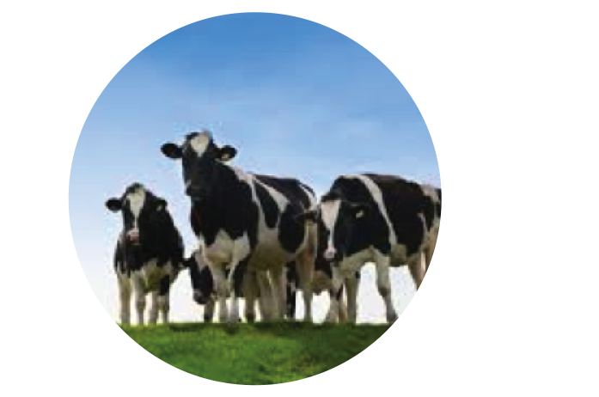
Veterinary Advances
Fowl pox vaccination
mice
White Nose syndrome
brown bats
Elephant endotheliotropic herpes virus
mice and rabbits
EBOLA IN WILD NONHUMAN PRIMATES—
mice, guinea pigs, nonhuman primates
Rumensin Antimicrobial
mice
Notes:
Through animal research, scientists better understand and have developed treatments for conditions affecting the animal kingdom including diseases affecting pets.
Sources: https://www.wsj.com/articles/love-your-dog-support-animal-research-1505672563; https://fbresearch.org/animal-research-helps-endangered-species/
Model system used for discovery is listed alongside veterinary advance
Fowl pox: virus produces lesions on bird’s skin, throat, and trachea; interferes with bird’s ability to eat, drink, and breathe normally
Rumensin: antimicrobial used to prevent and control coccidiosis parasite was originally developed through mouse research
EEHV: Asian elephants are highly susceptible to EEHV, a lethal strain of herpes; studying antibody responses to EEHV proteins in mice and rabbits aims to improve diagnostics and treatments for wild and captive elephants
White nose syndrome: bats’ wings are coated in white ‘fuzz’ during hibernation; fungus affects endangered Indiana and gray bat species; exposed common brown bats to white fungus to understand disease mechanisms
Ebola vaccines for NHPs: In Africa, there is currently consideration about vaccinating wild NHPs, mostly gorillas, from ebola to protect from local outbreaks that may cause a decline in population
Source: Ebola: The great ape gamble | Nature
https://speakingofresearch.com/facts/veterinary-benefits/

Slide 11
Regulations Governing Animal Research
In IACUC proposals, scientists must…
1. Cite literature to explain:
• Why their model is the appropriate experimental
subject to address the research question
• Why alternative research subjects (e.g., cell
culture and computer simulation) would not yield
similar information
• Why their potential results would not
unnecessarily duplicate previous research
2. Perform sample size calculations to determine
number of animals necessary
Many institutions are implementing animal
research conduct by following the 3 R’s:
• Replace with an alternative
• Refine methods to minimize pain and invasiveness
• Reduce the number of animals
Animal Welfare Act (AWA) and the Public Health Service (PHS) Policy require each research institution to appoint an Institutional Animal Care and Use Committee (IACUC) including a veterinarian and a non-affiliated public representative to review all experimental protocols, inspect facilities, and suspend any research practice not in compliance
Notes:
Each research institution oversees individual laboratories’ practices through an IACUC. The IACUC requires researchers to justify their work with animals and their use of the 3 Rs.
If you have gone through this process, may be helpful to provide examples IACUC has had on submitted reviews
Above source: https://www.darwinproject.ac.uk/commentary/life-sciences/darwin-and-vivisection
Below source: http://www.nabr.org/animal-welfare-2/animal-welfare-in-practice/functions-of-the-iacuc/
https://speakingofresearch.com/facts/research-regulation/

Slide 12
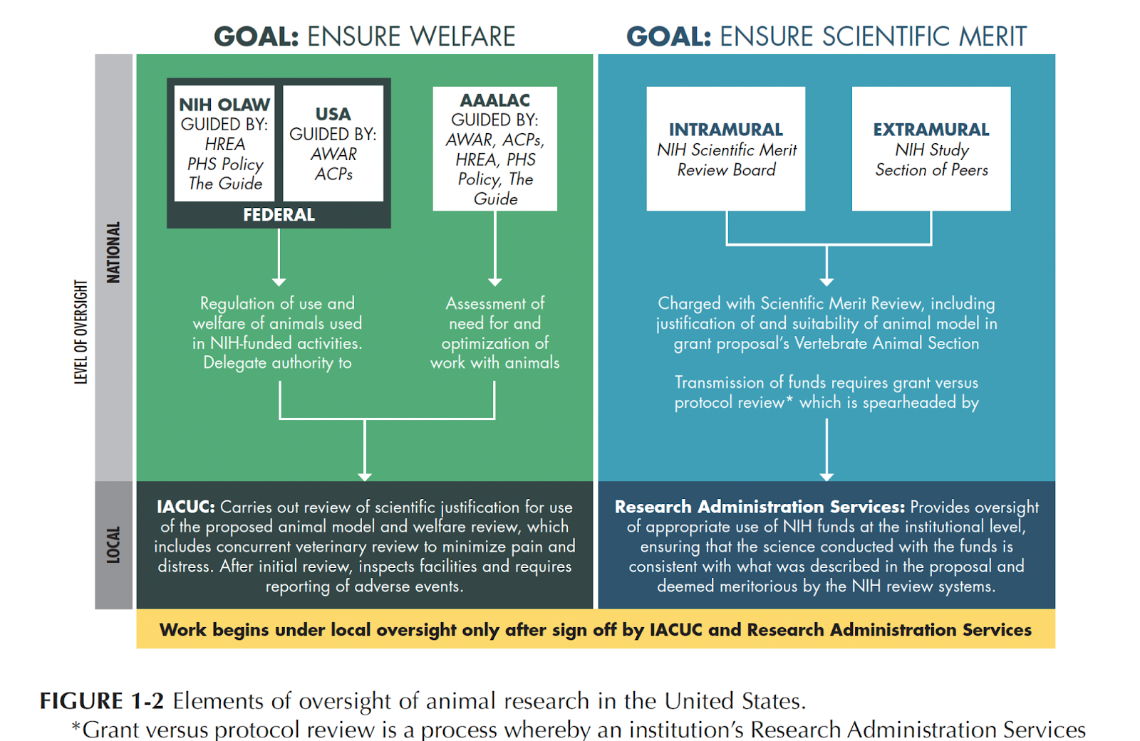
Animal Research Regulation and Scientific Merit
Notes:
Scientists work with laboratory animals in a regulated way as set forth by AWA and PHS.
Image from NASEM report
FDA:
Requires animal research for device and drug approval.
Devices – animal testing is only necessary if new material is used; biocompatibility testing is required
Drugs and Biologics – animal testing is used to determine drug absorption (into blood), drug metabolism, product and metabolite toxicity, speed of metabolite excretion
https://www.fda.gov/AboutFDA/Transparency/Basics/ucm194932.htm
OLAW:
https://grants.nih.gov/grants/olaw/olaw.htm
USDA:
https://www.nal.usda.gov/awic/animal-welfare-act

Slide 13
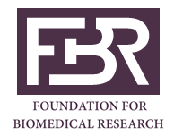

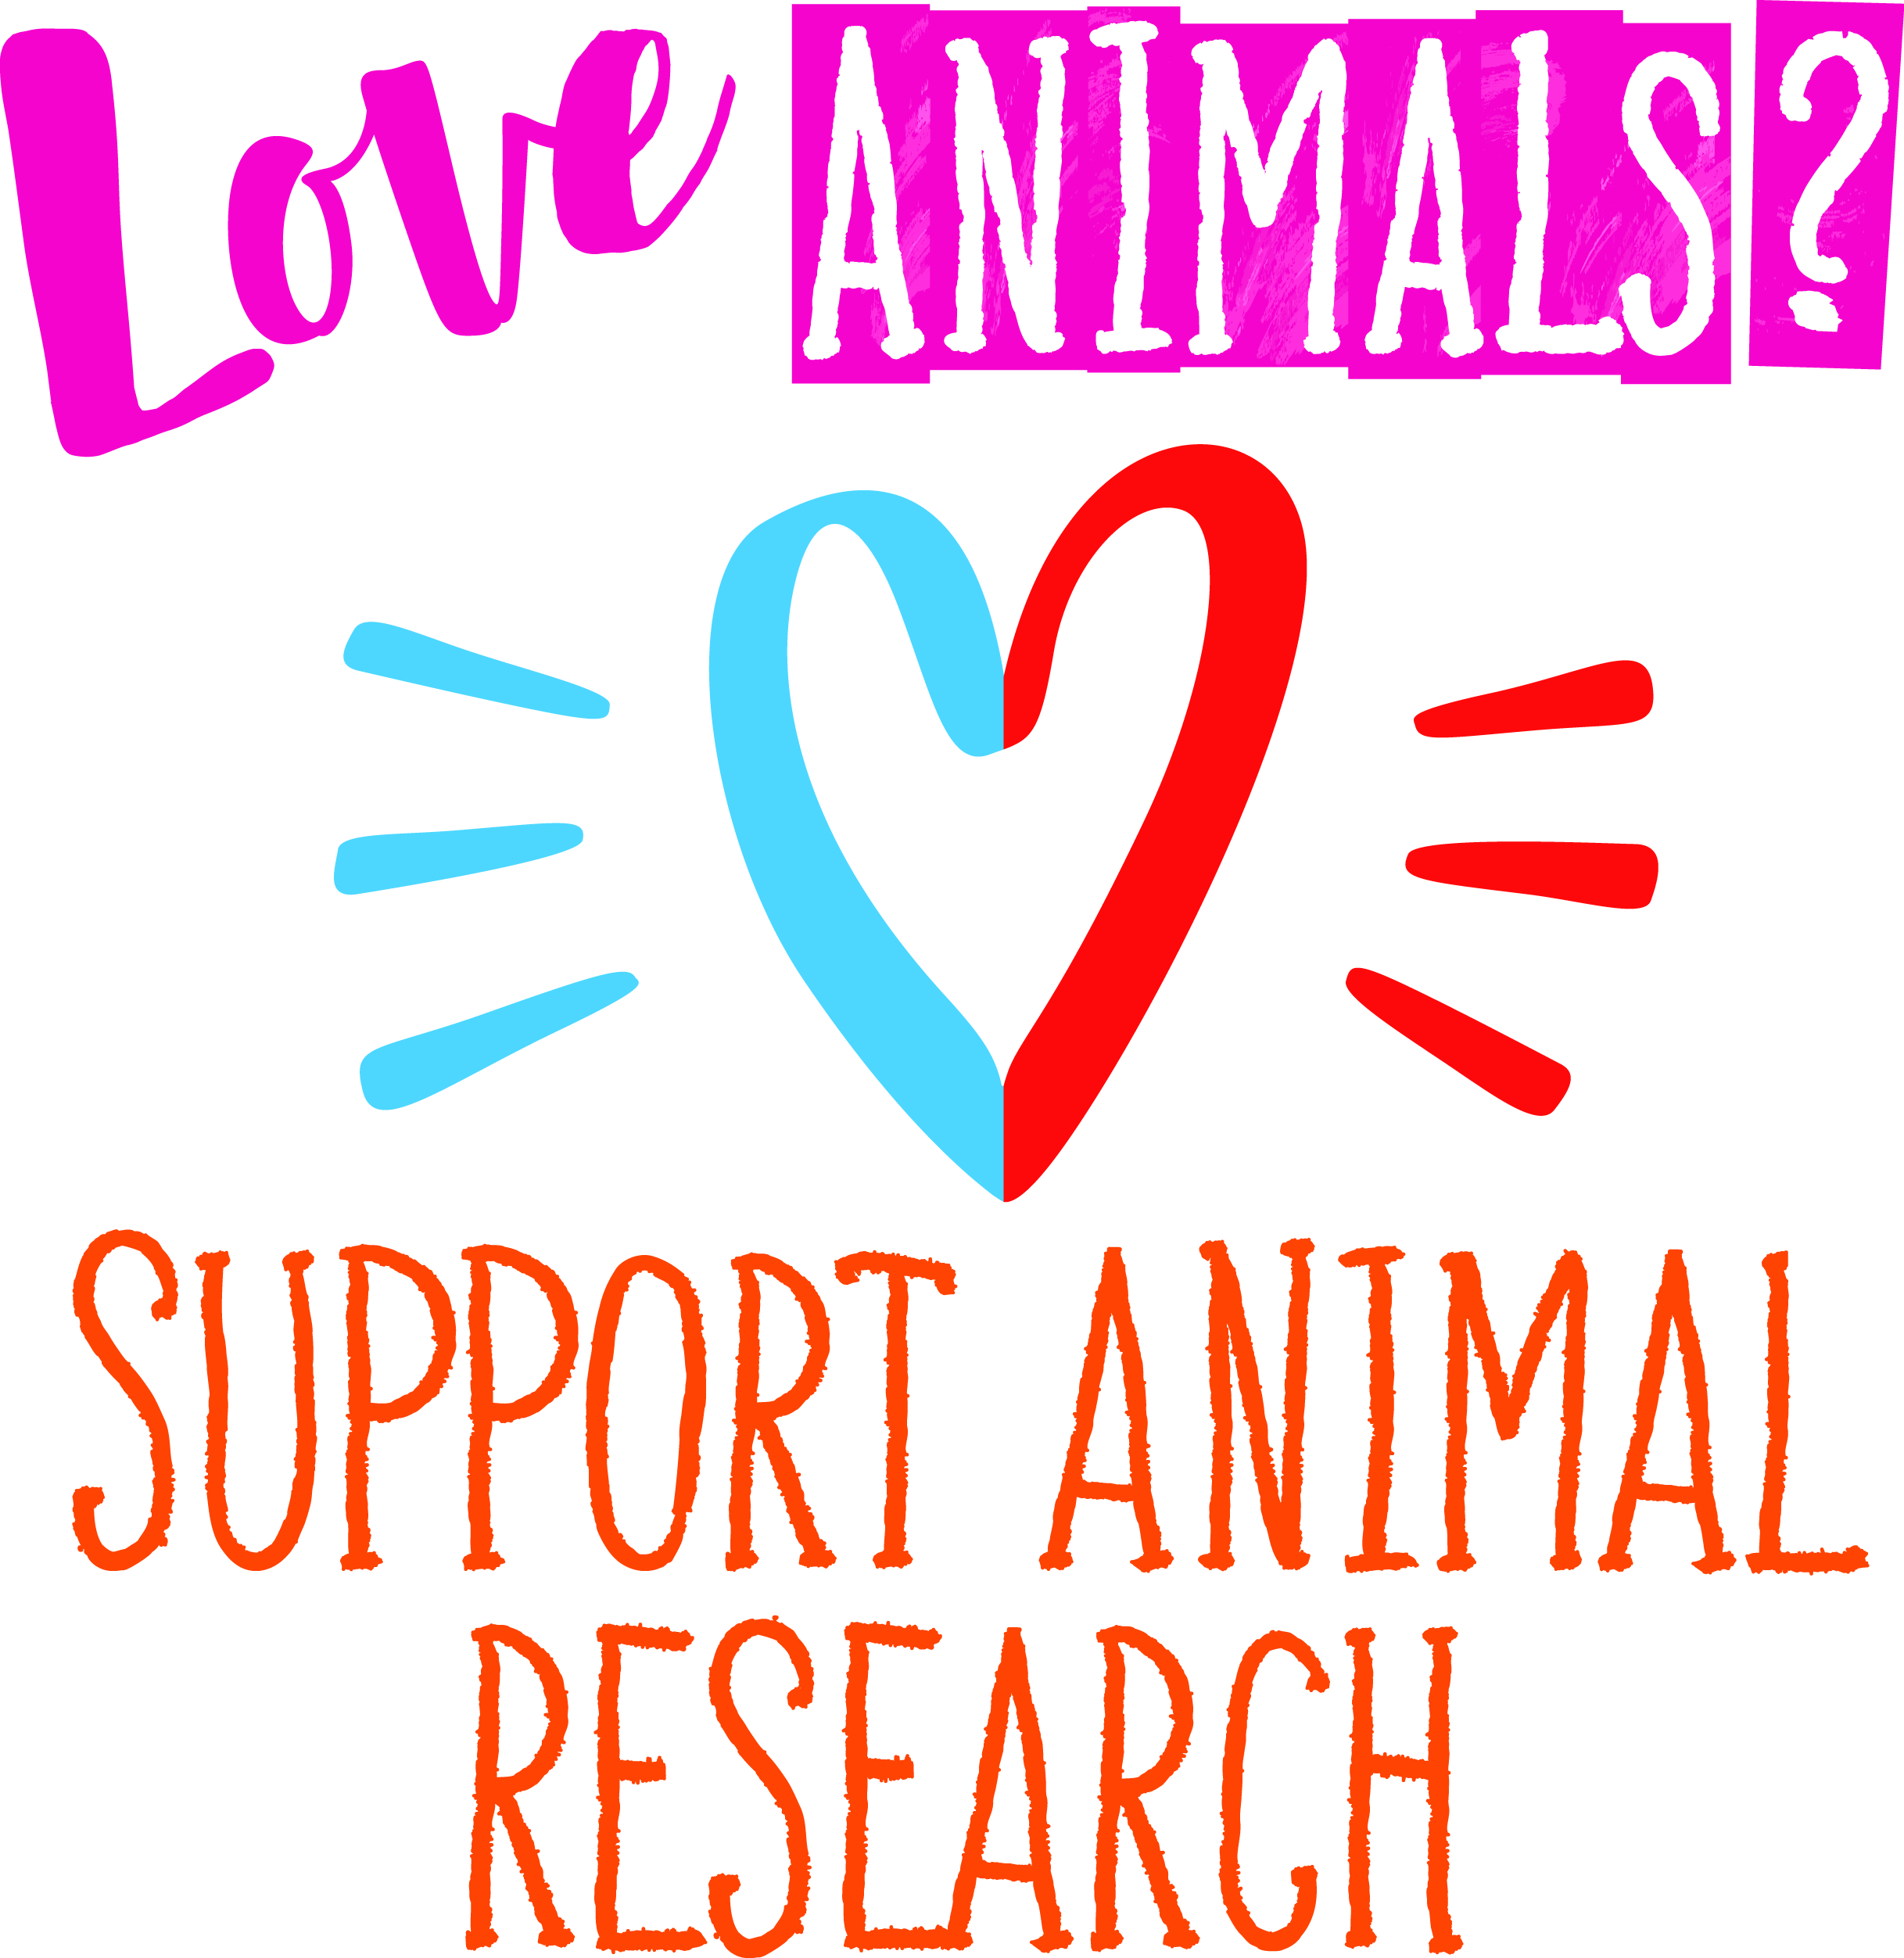

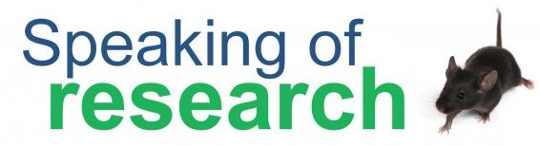

Animal Research Resources
Foundation for Biomedical Research
Americans for Medical Progress
Animals behind the 25 most
prescribed drugs
Species-specific examples of
animal research:
              1. Rodents
            2. Dogs
            3. Cats
            4. Nonhuman primates
        Come See Our World video
        Love Care Progress
        nonhuman primate video
Federation of European Neuroscience Societies
Speaking of Research
Association for Assessment and Accreditation of Laboratory Animal Care International
Notes:
Please utilize these resources for additional information.

